Slide 1
Bayesian Theory & Naïve Bayes Classifiers
Dept. of Computer Science
Faculty of Science and Technology

Slide 2
Bayesian Classifier
A statistical classifier: performs probabilistic prediction, i.e., predicts class membership probabilities
Foundation: Based on Bayes’ Theorem.
Performance: A basic Bayesian classifier, naïve Bayesian classifier, has comparable performance with decision tree and selected neural network classifiers
Standard: Even when Bayesian methods are computationally intractable, they can provide a standard of optimal decision making against which other methods can be measured

Slide 3
Bayes’ Theorem: Basics
Bayes’ Theorem:
Let X be a data sample (“evidence”): class label is unknown
Let H be a hypothesis that X belongs to class C
Classification is to determine P(H|X), (i.e., posteriori probability): the probability that the hypothesis holds given the observed data sample X
P(H) (prior probability): the initial probability
E.g., X will buy computer, regardless of age, income, …
P(X): probability that sample data is observed
P(X|H) (likelihood): the probability of observing the sample X, given that the hypothesis holds
E.g., Given that X will buy computer, the prob. that X is 31..40, medium income

Slide 4
Prediction Based on Bayes’ Theorem
Given training data X, posteriori probability of a hypothesis H, P(H|X), follows the Bayes’ theorem
Informally, this can be viewed as
posteriori = likelihood x prior/evidence
Predicts X belongs to C_{i} iff the probability P(C_{i}|X) is the highest among all the P(C_{k}|X) for all the k classes
Practical difficulty: It requires initial knowledge of many probabilities, involving significant computational cost

Slide 5
Classification Is to Derive the Maximum Posteriori
Let D be a training set of tuples and their associated class labels, and each tuple is represented by an n-D attribute vector X = (x₁, x₂, …, x_{n})
Suppose there are m classes C₁, C₂, …, C_{m}.
Classification is to derive the maximum posteriori, i.e., the maximal P(C_{i}|X)
This can be derived from Bayes’ theorem
Since P(X) is constant for all classes, only
needs to be maximized

Slide 6
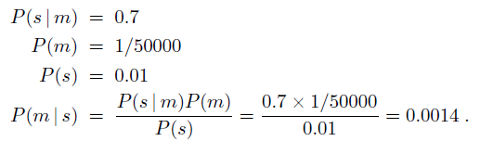
Applying Bayes’ rule: A basic Example
A doctor knows that the disease meningitis causes the patient to have a stiff neck, say, 70% of the time. The doctor also knows some unconditional facts: the prior probability that a patient has meningitis is 1/50,000, and the prior probability that any patient has a stiff neck is 1%.
Letting
s be the proposition that the patient has a stiff neck and
m be the proposition that the patient has meningitis, we have

Slide 7
Bayesian Methods
Learning and classification methods based on probability theory.
Bayes theorem plays a critical role in probabilistic learning and classification.
Uses prior probability of each category given no information about an item.
Categorization produces a posterior probability distribution over the possible categories given a description of an item.

Slide 8
Bayes Classifiers
Assumption: training set consists of instances of different classes described cj as conjunctions of attributes values
Task: Classify a new instance d based on a tuple of attribute values into one of the classes cj ∈ C
Key idea: assign the most probable class using Bayes Theorem.

Slide 9
Naïve Bayes Classifier
A simplified assumption: attributes are conditionally independent (i.e., no dependence relation between attributes):
This greatly reduces the computation cost: Only counts the class distribution
If A_{k} is categorical, P(x_{k}|C_{i}) is the # of tuples in C_{i} having value x_{k} for A_{k} divided by |C_{i, D}| (# of tuples of C_{i} in D)
If A_{k} is continous-valued, P(x_{k}|C_{i}) is usually computed based on Gaussian distribution with a mean μ and standard deviation σ
and P(x_{k}|C_{i}) is

Slide 10
Parameters estimation
P(c_{j})
Can be estimated from the frequency of classes in the training examples.
P(x₁,x₂,…,x_{n}|c_{j})
O(|X|^{n}•|C|) parameters
Could only be estimated if a very, very large number of training examples was available.
Independence Assumption: attribute values are conditionally independent given the target value: naïve Bayes.

Slide 11
Naïve Bayes Classifier: Training Dataset
Class:
C1:buys_computer = ‘yes’
C2:buys_computer = ‘no’
Data to be classified:
X = (age <=30,
Income = medium,
Student = yes
Credit_rating = Fair)

Slide 12
Naïve Bayes Classifier: An Example
P(C_{i}): P(buys_computer = “yes”) = 9/14 = 0.643
P(buys_computer = “no”) = 5/14= 0.357
Compute P(X|C_{i}) for each class
P(age = “<=30” | buys_computer = “yes”) = 2/9 = 0.222
P(age = “<= 30” | buys_computer = “no”) = 3/5 = 0.6
P(income = “medium” | buys_computer = “yes”) = 4/9 = 0.444
P(income = “medium” | buys_computer = “no”) = 2/5 = 0.4
P(student = “yes” | buys_computer = “yes) = 6/9 = 0.667
P(student = “yes” | buys_computer = “no”) = 1/5 = 0.2
P(credit_rating = “fair” | buys_computer = “yes”) = 6/9 = 0.667
P(credit_rating = “fair” | buys_computer = “no”) = 2/5 = 0.4
X = (age <= 30 , income = medium, student = yes, credit_rating = fair)
P(X|C_{i}) : P(X|buys_computer = “yes”) = 0.222 x 0.444 x 0.667 x 0.667 = 0.044
P(X|buys_computer = “no”) = 0.6 x 0.4 x 0.2 x 0.4 = 0.019
P(X|C_{i})*P(C_{i}) : P(X|buys_computer = “yes”) * P(buys_computer = “yes”) = 0.028
P(X|buys_computer = “no”) * P(buys_computer = “no”) = 0.007
Therefore, X belongs to class (“buys_computer = yes”)

Slide 13
What is discriminant Function
For classification problem, for each class, define a function such that we choose Ci if

Slide 14
K=2 Classes
Dichotomizer (K=2) vs Polychotomizer (K>2)
g(x) = g₁(x) – g₂(x)
Log odds:

Slide 15
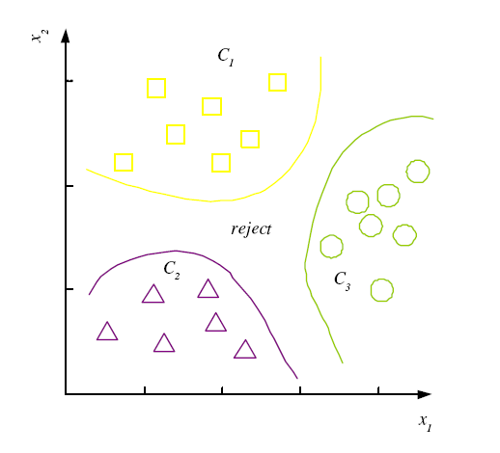
Discriminant Functions
K decision regions R₁,...,R_{K}

Slide 16
Properties
Estimating instead of greatly reduces the number of parameters (and the data sparseness).
The learning step in Naïve Bayes consists of estimating and based on the frequencies in the training data
An unseen instance is classified by computing the class that maximizes the posterior
When conditioned independence is satisfied, Naïve Bayes corresponds to MAP classification.

Slide 17
Maximum A Posterior
Based on Bayes Theorem, we can compute the Maximum A Posterior (MAP) hypothesis for the data
We are interested in the best hypothesis for some space H given observed training data D.
H: set of all hypothesis.
Note that we can drop P(D) as the probability of the data is constant (and independent of the hypothesis).

Slide 18
Desirable Properties of Bayes Classifier
Incrementality: with each training example, the prior and the likelihood can be updated dynamically: flexible and robust to errors.
Combines prior knowledge and observed data: prior probability of a hypothesis multiplied with probability of the hypothesis given the training data
Probabilistic hypothesis: outputs not only a classification, but a probability distribution over all classes

Slide 19
Naïve Bayes Classifier: Comments
Advantages
Easy to implement
Good results obtained in most of the cases
Disadvantages
Assumption: class conditional independence, therefore loss of accuracy
Practically, dependencies exist among variables
E.g., hospitals: patients: Profile: age, family history, etc.
Symptoms: fever, cough etc., Disease: lung cancer, diabetes, etc.
Dependencies among these cannot be modeled by Naïve Bayes Classifier

